Slide 1
Evolving Telematics
Greg Brannon
Director, Auto Engineering and Industry Relations
American Automobile Association
Notes:
What is Connected Car
How it impacts you
Opportunities
What we all can do
<Start with short video on Connected Car>

Slide 3
Connected Car Landscape
Internet Radio
Vehicle OEMs
Travel Industry
Location Based
Services (LBS)
Social Networking
Roadside
Vehicle Repair
Wireless
100% of all new cars and more than 50% of all cars on the road will be ‘Connected’ by 2024

Slide 4
How will the evolution of the
connected car
impact
you?

Slide 5
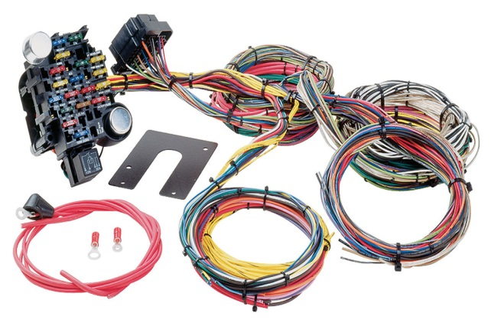
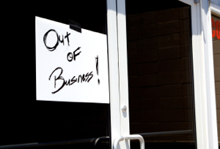
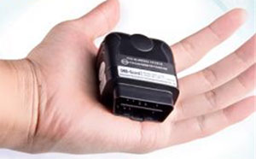
History of Access to Vehicle Data
1987 – Cars became more computerized, preventing independent repair shops from properly diagnosing and repairing vehicles.
1991 – Small shops were being threatened by lack of information.
1991 - 1994 – OEMs were forced by EPA/CARB to work together under SAE guidelines.
1994 – EPA/CARB forced OEMs to develop the OBDII Diagnostic Connector and specifications were developed to be implemented in 1996 vehicles.
Notes:
This is history that I was part of
Took seven years
If we did not act, consumers would have suffered

Slide 6
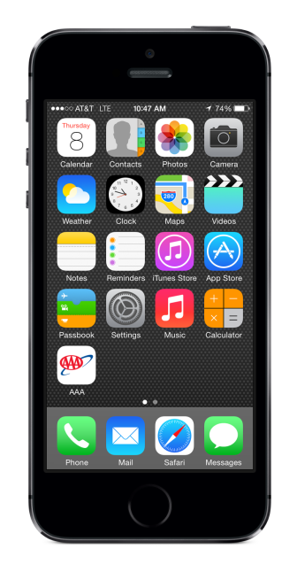
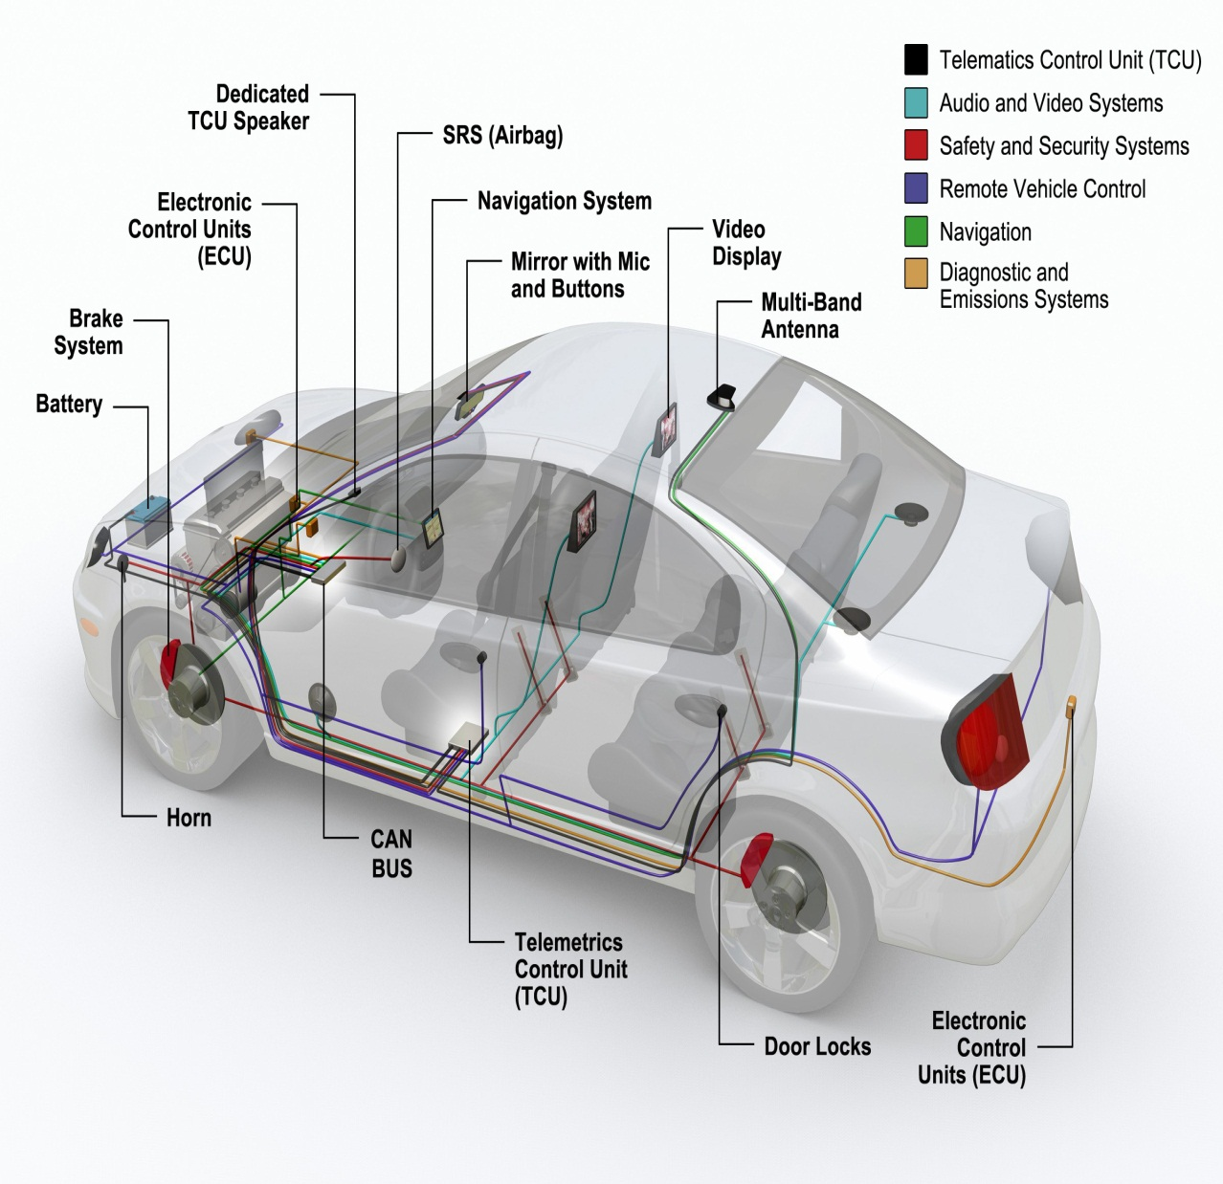
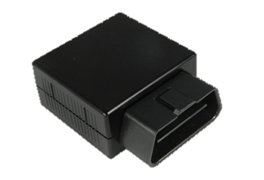
Fast forward to today…
2007 – iPhone released
The Connected Car
Bluetooth Enabled Dongle
the same scenario is happening.
Notes:
Cars have more computers
Phones are ever more complicated
Connections between phones/car are available

Slide 7
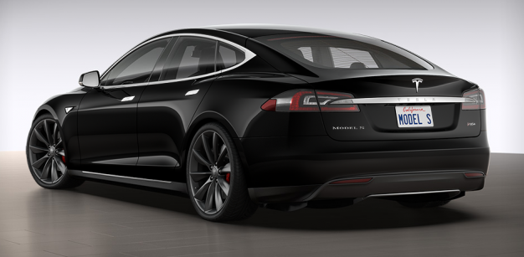
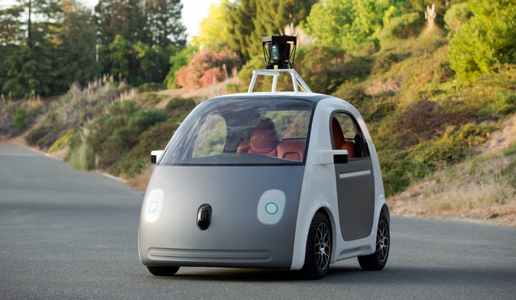
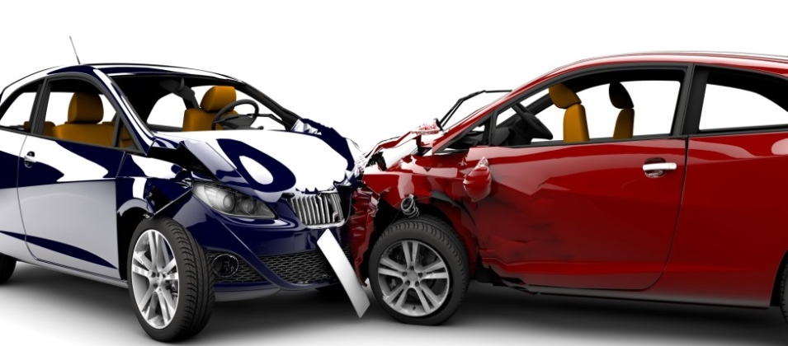
Challenges
Technology is making vehicles more reliable and impacting maintenance schedules, leading to fewer visits to repair facilities.
Increasing vehicle complexity is making repairs more challenging.
Advanced Driver Assistance Systems (ADAS) and Vehicle to Vehicle (V2V) technology have the potential to lessen the number of accidents and repairs.
Notes:
Technology is increasingly in cars
Complexity is challenging
Driving is more dependent upon computers

Slide 8
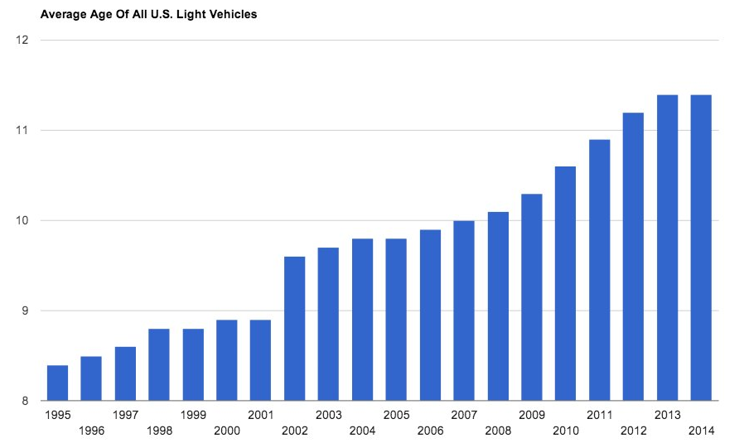
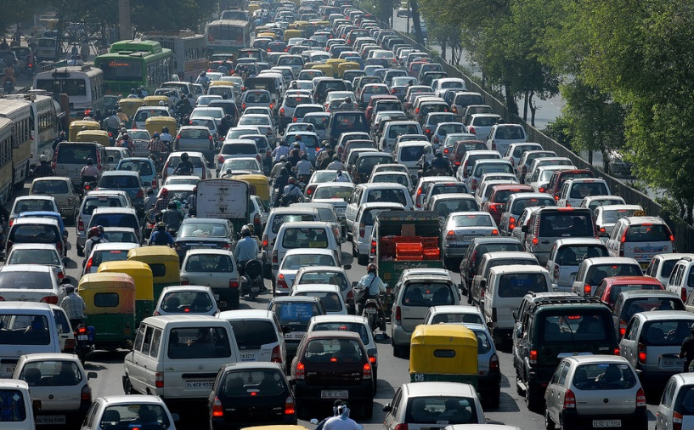
Opportunities
Vehicles are lasting a lot longer (average age is 11.4 years) and older vehicles are likely to require more service.
The number of vehicles on the road continues to increase every year (now over 250 million).
Notes:
Better cars
More congestion

Slide 9
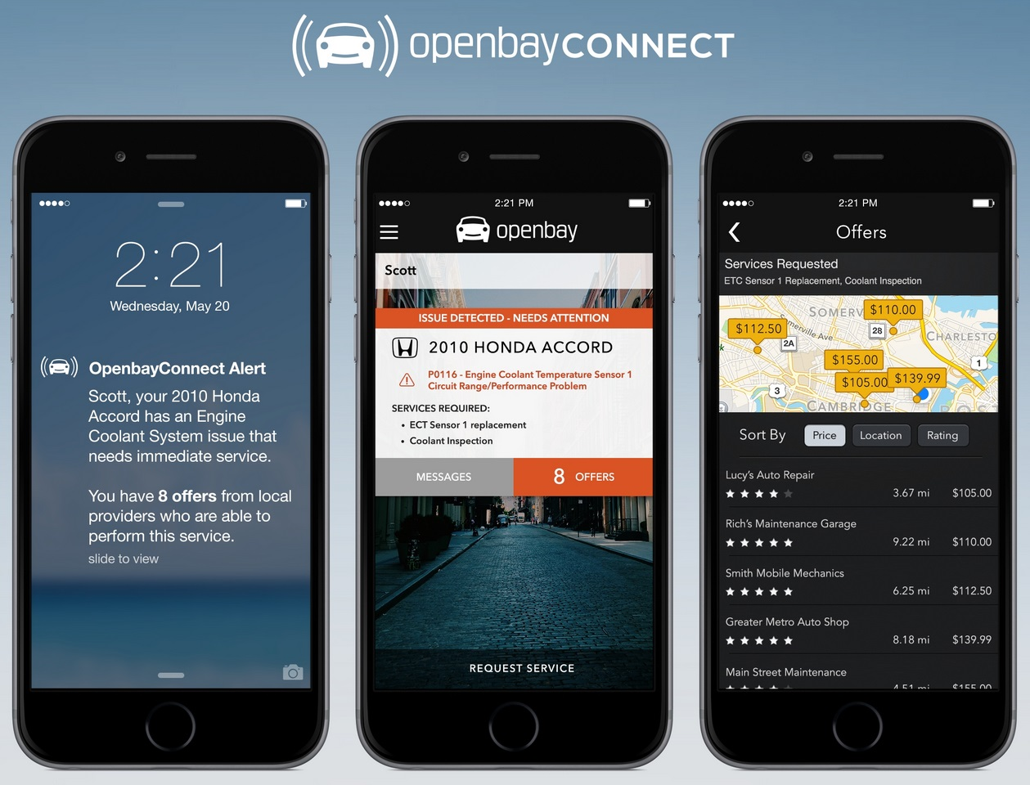
Remote Diagnostics?
Binding quote?

Slide 10
How can
you adapt
to stay ahead of the
curve?
Notes:
What can we all do?
Teamwork and voice of consumer is key

Slide 11
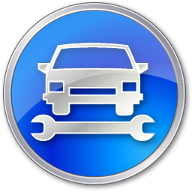
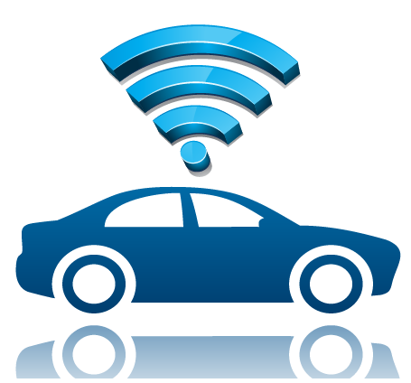
Telematics Ecosystem
OEM
DEALER
INDEPENDENT

Slide 12
Thank you

